Slide 1

Guessing Game
Roberto Griffin

Slide 2
The idea
I wanted to make a game that I could use a GUI.
I used an abstract Interface, a multitude of different classes and inheritance
I made my GUI with SceneBuilder.

Slide 3
How
I first created a new JavaFX class called The Game.
I implemented an FXML file into the class and I used that file to open scene builder with.
Here’s what I came up with

Slide 4
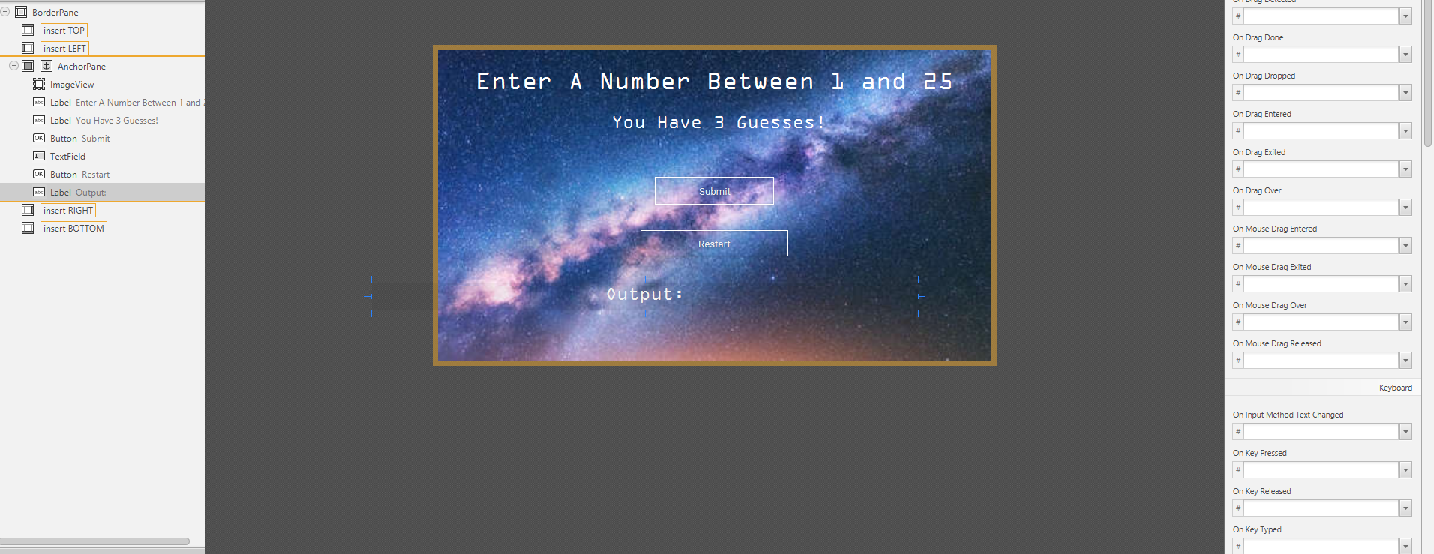
My Design

Slide 5
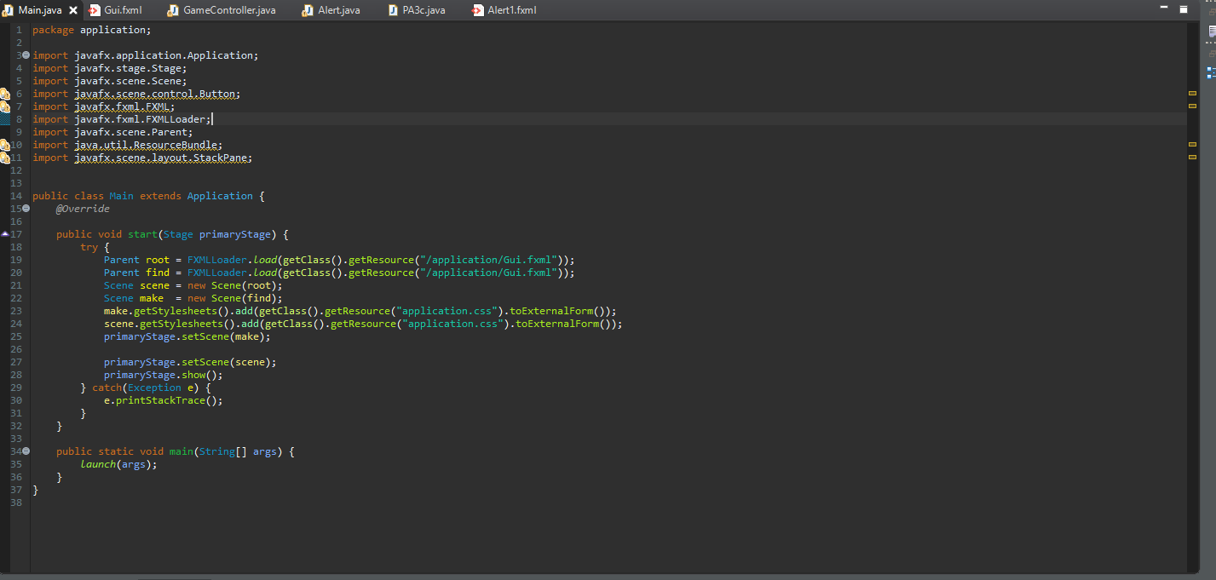
Main class

Slide 6
Controller
Here I used a lot different classes to try and loop the entire game.
I had and still have one major issue.
I defined a bunch of if then statements to set boundaries for the game

